Slide 1
OOPs in Python

Slide 2

Index
OOPs in Python
• Encapsulation
• Introduction
• Private Variables
• Private Methods
• Protected
• Setter and Getter Methods

Slide 3
Encapsulation
Introduction:
· Encapsulation is the process of restricting access to methods and variables and preventing from the data being modified both accidently and intentionally.
· Python has different levels of restrictions that control the accessing of data.
· Variables and methods can be public , private or protected. These are made by using the underscores symbols.
Public:
· Public variables and methods can be freely modified and run from anywhere, either inside or outside of the class. To create a public variable or method, don't use any underscores.

Slide 4
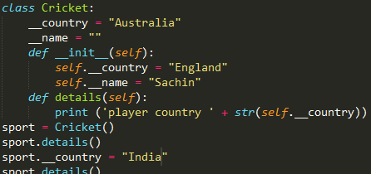

Encapsulation
Private Variables:
· The private variable or method can be accessed from within its own class or object.
· Private variable value cannot be modified from outside of a class.
· Private variables and methods are declared by two underscores.
Example:
· In the example we declared two private variable __country and __name which can be used inside the class.

Slide 5
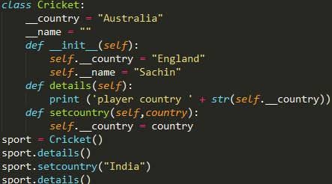

Encapsulation
· In example even though we changed the value of country to “india” but the country name will not change this is because the variables exist independently.
· To overcome this drawback we can use a method called set method which sets the value to private variable.
Example:
· Here we change the value of country to “India” by using a setcountry (you can give it any name) method.

Slide 6
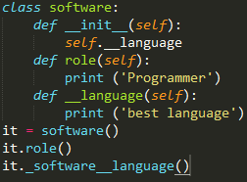
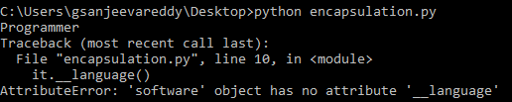
Encapsulation
Private Methods:
· When a class is created with a private method.
· Object for the class is created to access methods in the class.
· If tried to access private methods it will display an error that the method does not exist.
Correct way to access it is obj._cls.__method()
Example:
· It returns an error when accessing private method because it cannot be accessed directly from outside the class.

Slide 7

Encapsulation
· Python provide a different method that can be used to access private method from outside the class is objectname._classname.__methodname.
Example:
· calling with classname will give access to private methods and output will be
displayed.
Protected :
· Protected member is accessible only from within the class and it’s subclasses.
· We can add values to them by using conventions this done by prefixing the name of variable with underscore as _variablename.

Slide 8
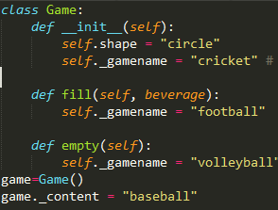
Encapsulation
· Accessing protected variables is same as private variables by using
Classname along with objectname.
· Variable written with single underscore indicates a protected variable.
Example:
·

Slide 9
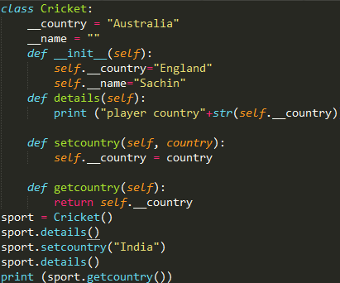

Encapsulation
Setter and Getter:
· The methods that are used to for interacting with encapsulated variables are by setter and getter.
· Setter method is used to set values to variable and getter is used to retrieve value from the variable.
· These are used because the methods exist within the class with which accessing private variables is easy when compared to outside class.
Example:

